Slide 1


LOGISTICS OPTIMIZATION FOR DELIVERY ROUTES – AMAZON
A Data-Driven Analysis of Route Efficiency, Warehouse Performance, and Delivery Optimization
Aditya KUMAR GUPTA

Slide 2
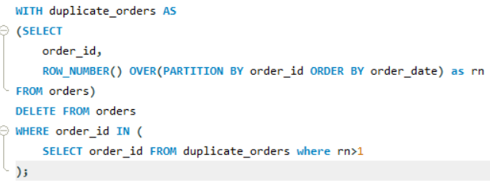
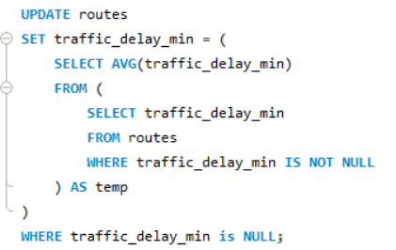
Task 1: Data Cleaning & Preparation
Identify Duplicates
Replace null Traffic_Delay_Min with the average delay for that route. Optimization

Slide 3
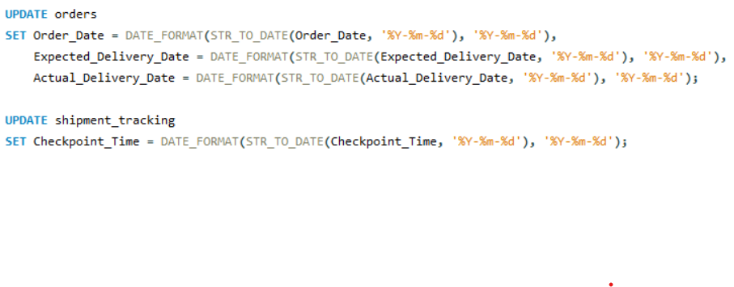
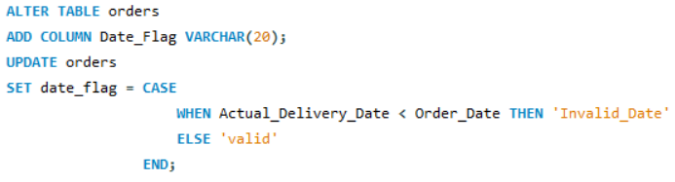
Task 1: Data Cleaning & Preparation
Convert date to YYYY-MM-DD
Ensure that no Actual_Delivery_Date is before Order_Date.

Slide 4
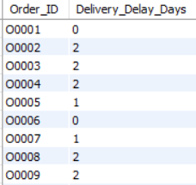
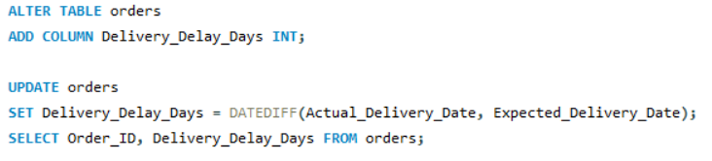
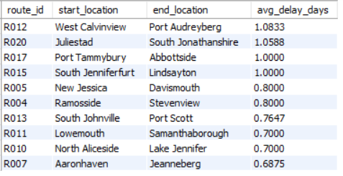
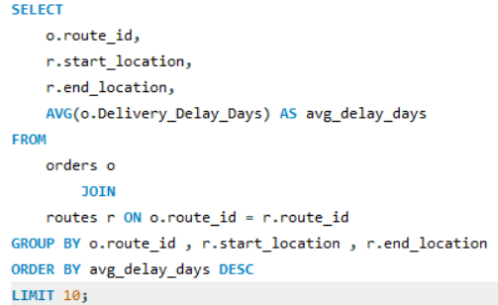
Task 2: Delivery Delay Analysis
Calculate delivery delay (in days) for each order.
Find Top 10 delayed routes based on average delay days.

Slide 5
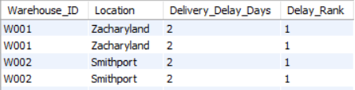
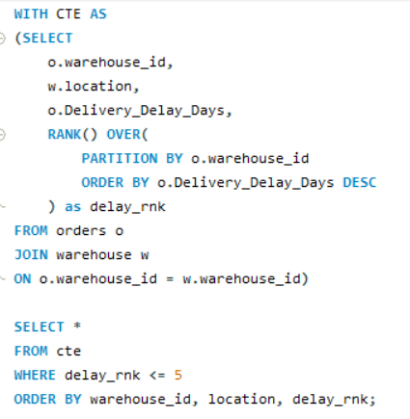



Task 2: Delivery Delay Analysis
Use window functions to rank all orders by delay within each warehouse.

Slide 6
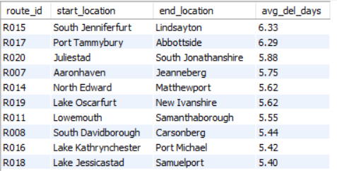
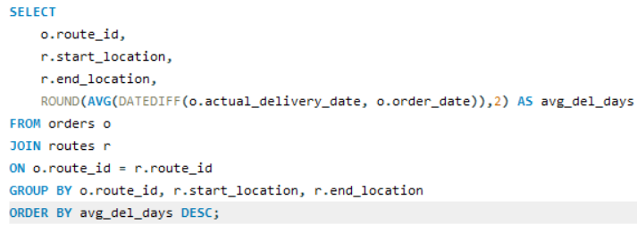
Task 3: Route Optimization Insights
For each route, calculate:
  Average delivery time (in days).

Slide 7
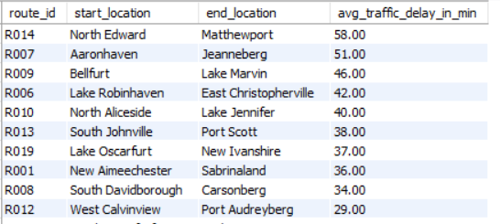
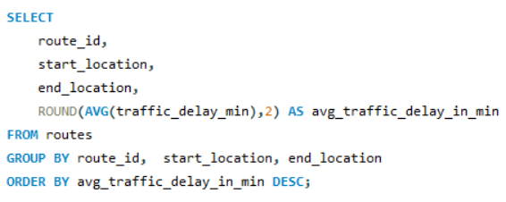
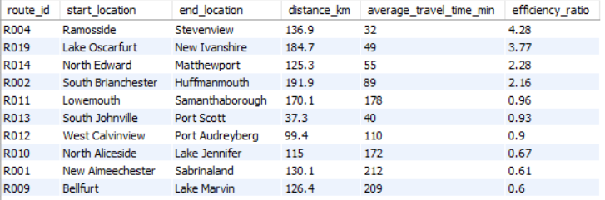
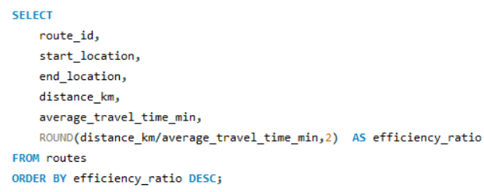
Task 3: Route Optimization Insights
For each route, calculate:
  Average traffic delay.
  Distance-to-time efficiency ratio: Distance_KM / Average_Travel_Time_Min.

Slide 8

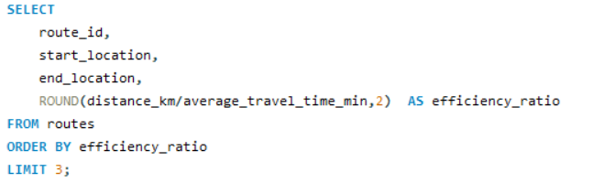
Task 3: Route Optimization Insights
Identify 3 routes with the worst efficiency ratio.

Slide 9
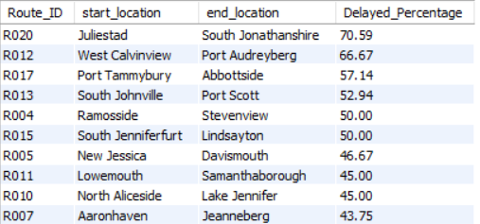
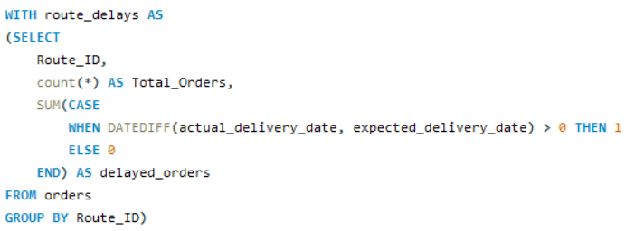
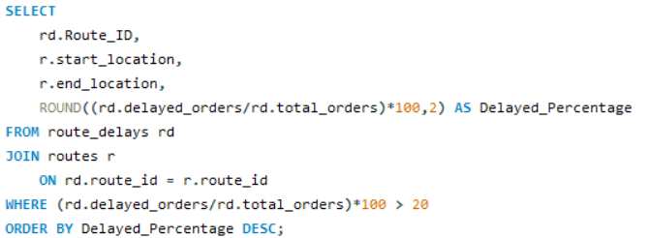
Task 3: Route Optimization Insights
Find routes with >20% delayed shipments.

Slide 10
Task 3: Route Optimization Insights
Recommend potential routes for optimization.
  On the basis of average delivery time (in days), we can consider Route_IDs like R015 and R017 for route rescheduling because these routes have higher delivery delay — if we take 6 days as a reasonable delivery buffer.
  Routes such as R016, R006, and R008 show lower efficiency ratios compared to other routes.This indicates that deliveries along these routes are taking longer travel times relative to their distance, which may be due to lower average driver speed or traffic congestion. These routes should be reviewed for possible re-optimization or schedule adjustments to improve delivery performance.
  All analyzed routes show over 20 % delayed shipments, indicating that delivery delays are not limited to specific routes but are a network-wide issue. Therefore, route re-optimization should be prioritized across the logistics network, focusing on factors such as traffic congestion, scheduling efficiency, and resource allocation to reduce overall delays.

Slide 11

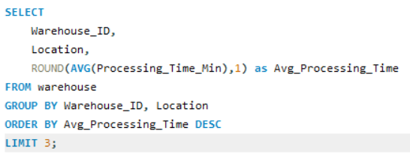
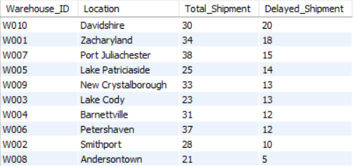
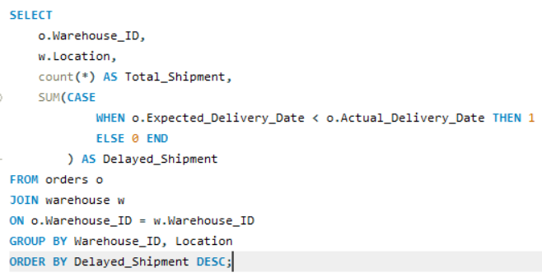
Task 4: Warehouse Performance
Find the top 3 warehouses with the highest average processing time.
Calculate total vs. delayed shipments for each warehouse.

Slide 12
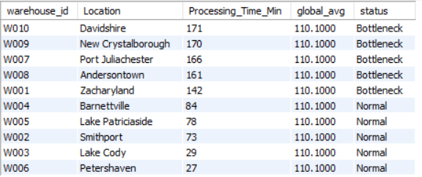
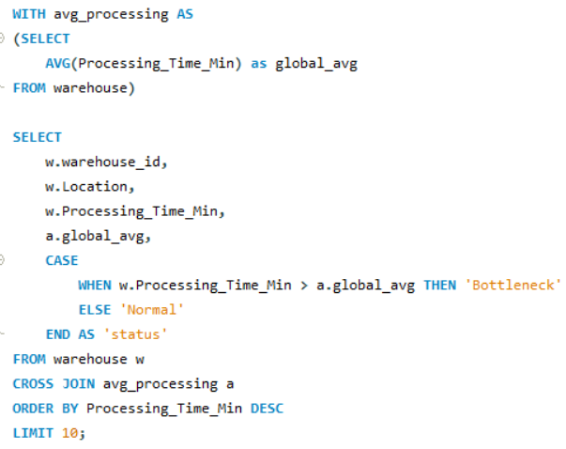
Task 4: Warehouse Performance
Use CTEs to find bottleneck warehouses where processing time > global average.

Slide 13
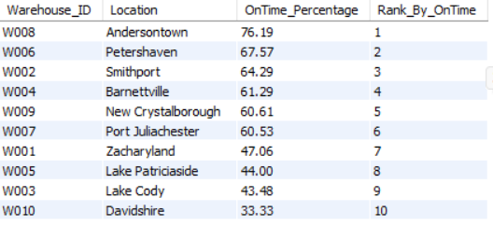
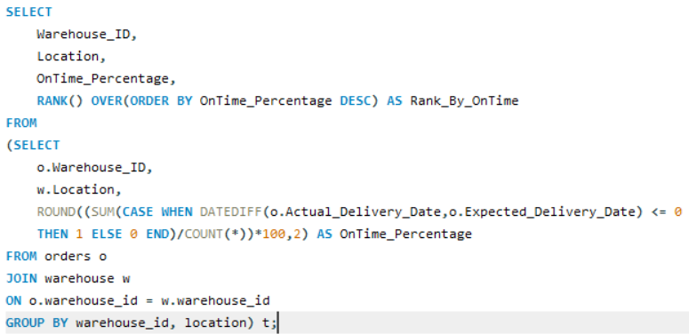
Task 4: Warehouse Performance
Rank warehouses based on on-time delivery percentage.

Slide 14
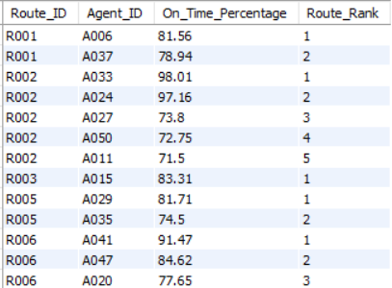
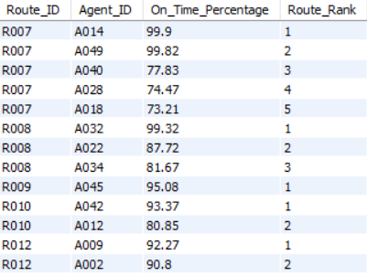
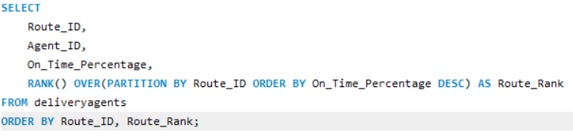
Task 5: Delivery Agent Performance
Rank agents (per route) by on-time delivery percentage.

Slide 15
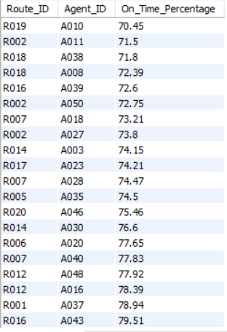
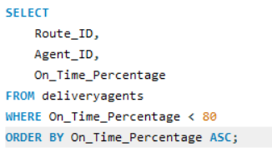
Task 5: Delivery Agent Performance
Find agents with on-time % < 80%.

Slide 16
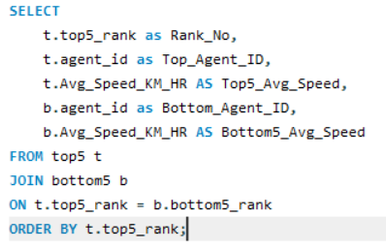
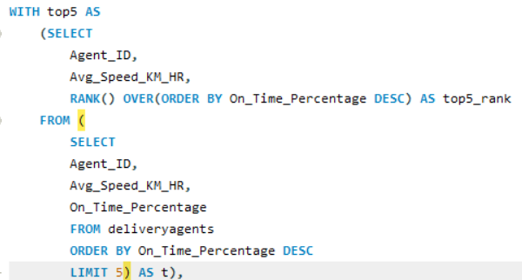
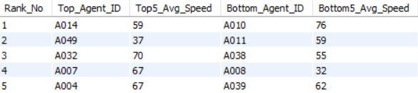
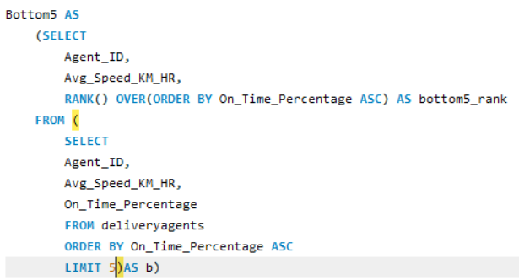
Task 5: Delivery Agent Performance
Compare average speed of top 5 vs bottom 5 agents using subqueries.

Slide 17
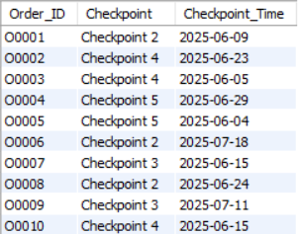
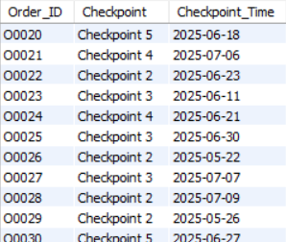
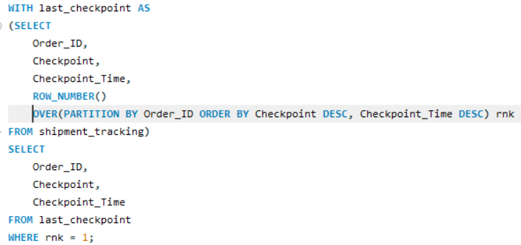
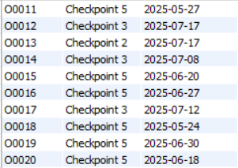
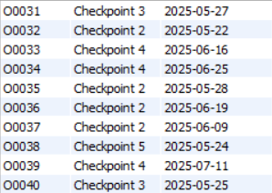
Task 6: Shipment Tracking Analytics
For each order, list the last checkpoint and time.

Slide 18

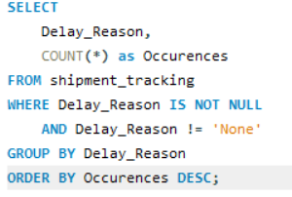
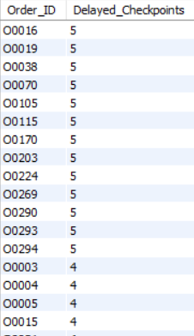
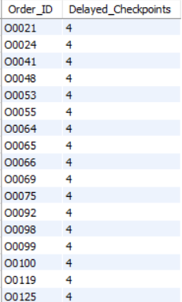
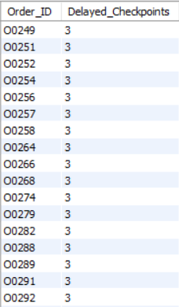
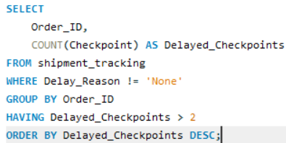
Task 6: Shipment Tracking Analytics
Find the most common delay reasons (excluding None).
Identify orders with >2 delayed checkpoints

Slide 19
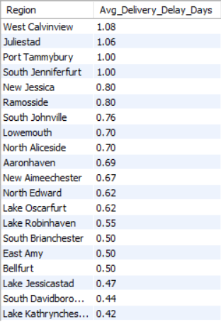
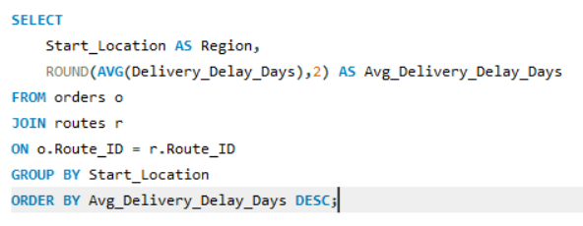
Task 7: Advanced KPI Reporting
Average Delivery Delay per Region (Start_Location).

Slide 20

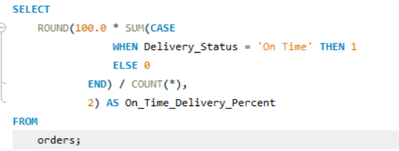
Task 7: Advanced KPI Reporting
On-Time Delivery % = (Total On-Time Deliveries / Total Deliveries) * 100.

Slide 21
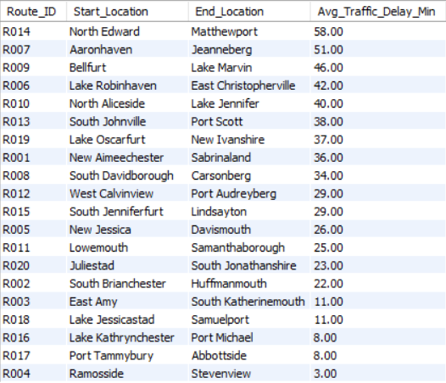

Task 7: Advanced KPI Reporting
Average Traffic Delay per Route.

